Slide 1




E-waste Collection and Recycling Behaviours: An Agent-Based Model for Intervention Assessment in Singapore
The International Academy for Production Engineering
32nd CIRP Conference on Life Cycle Engineering (LCE2025) – Apr. 7-9 2025
by
Quoc Khanh Tran, Lan Zhao, Yajuan Sun, Gaoxi Xiao, Zhiquan Yeo, Chuan Fu Tan
Presenting author: Quoc Khanh Tran – Hanoi University of Science and Technology
Email: khanh.tq190085@sis.hust.edu.vn
Procedia CIRP
www.LCE2025.com
CIRP office: 9 rue Mayran, 75009 PARIS – France, E mail: cirp@cirp.net, http://www.cirp.net

Slide 2
Agenda
Introduction
Modeling Methodology
Experiment Results
Conclusion and Developments

Slide 3
Introduction

Slide 4


What would you do, if you had a no-longer-used smartphone?
60% of Singapore residents do not know or are unsure of how to recycle their electronic waste.

Slide 5
Research Problem
Significant increase of electronic waste (e-waste) generation.
62 millions metric tons, approximately 155,000 Boeing 747s, of e-waste was generated in 2022 globally.
E-waste is:
Valuable raw material, e.g. gold, silver, and copper.
Environmentally hazardous.
Only 22.3% were documented as formally recycled worldwide.
Only 6% of 60,000 tonnes e-waste generated each year in Singapore are recycled.
→ Model e-waste collection for policymakers to assess recycling interventions.

Slide 6
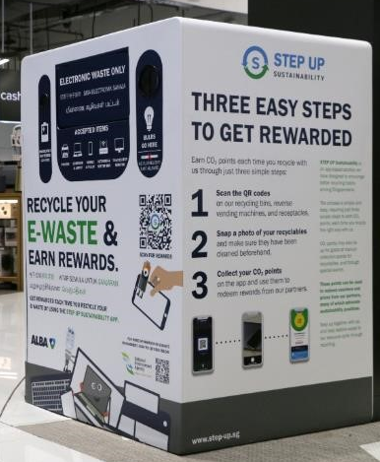
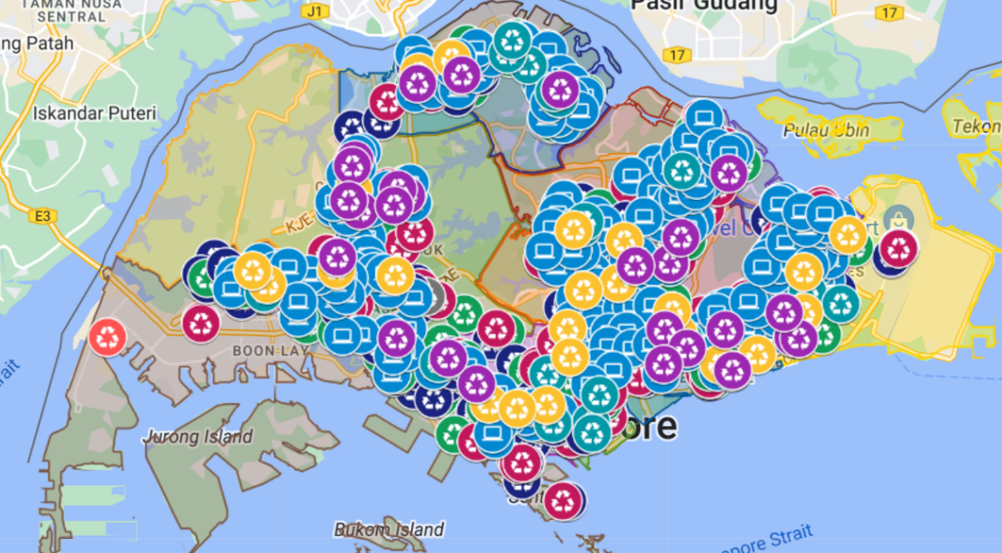
E-waste Management in Singapore
Extended Producer Responsibility (EPR): producers are responsible for their end-of-life products.
E-Bins in public areas across Singapore to collect e-waste.
Locations of E-Bins in Singapore, information from National Environment Agency.
A 3-in-1 e-bin placed at Harvey Norman Millenia Walk. Photo from National Environment Agency.

Slide 7
Modeling methodology

Slide 8
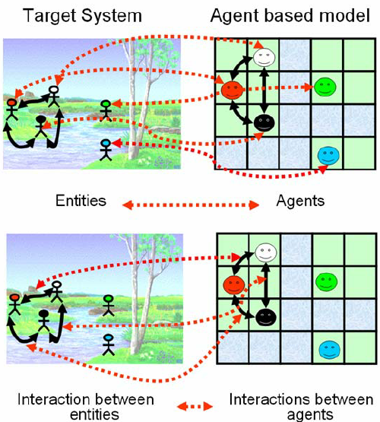
Agent-Based Modeling (ABM)
Agent-Based Modeling: A computational method to study interactions between individuals.
Agent: autonomous entity with unique characteristics and behaviours.
Emergence: system-level phenomenon arises from agent interactions, unpredictable from individual components.
E-waste collection system: a Complex Adaptive System (CAS) composes of multiple interacting components that adapt to changes.
→ ABM is suitable to simulate e-waste collection system.
Illustration of Agent-Based Modeling. Figure extracted from Galán et al.

Slide 9
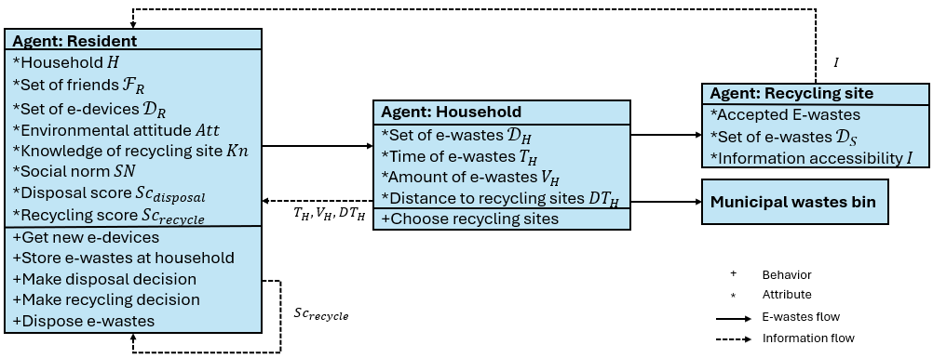
Modeling Framework
Agent-based model for e-waste collection and recycling behaviours.
Agents in the model: Resident, Household, and Recycle Site.
Conceptual model of the agent-based model for e-waste collection and recycling behaviours.

Slide 10
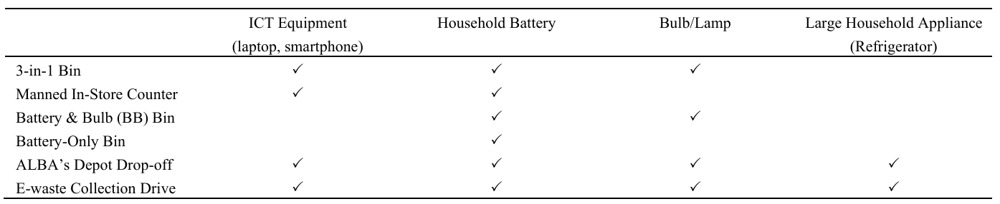
Recycling Site and E-waste
Type of recycling sites: 3-in-1 Bin, Manned In-Store Counter, Battery & Bulb Bin, Battery-Only Bin, ALBA’s Depot Drop-Off, and E waste Collection Drive
Types of e-wastes: ICT equipment (laptop, smartphone), household battery, bulb/lamp, large household appliance (refrigerator).
Recycling sites and their accepted types of e-wastes in our model.

Slide 11


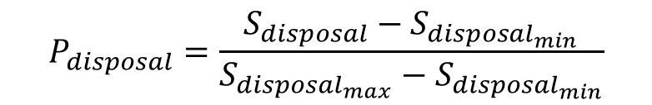
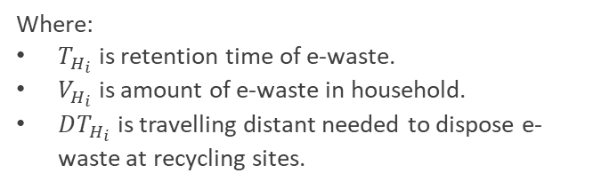
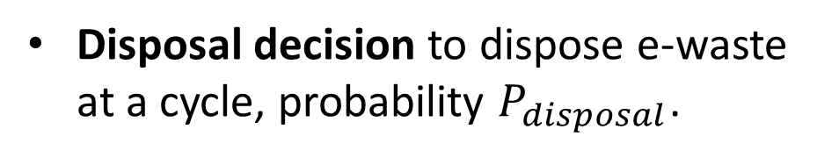
Resident
Disposal decision to dispose e-waste at a cycle, probability $P_{disposal}$.
Get new devices.
Make disposal decision.
$$S_{disposal}=α_{T}⋅T_{H_{i}}+α_{V}⋅V_{H_{i}}+α_{DT}⋅DT_{H_{i}}$$
Dispose e-waste?
No
$$P_{disposal}=\frac{S_{disposal}−S_{disposal_{min}}}{S_{disposal_{max}}−S_{disposal_{min}}}$$
New cycle
Yes
Where:
$T_{H_{i}}$ is retention time of e-waste.
$V_{H_{i}}$ is amount of e-waste in household.
$DT_{H_{i}}$ is travelling distant needed to dispose e-waste at recycling sites.
Make recycling decision.
New cycle
New cycle
Recycling sites
Disposing channel?
Municipal wastes bin
Transfer to recycling sites.
Transfer to municipal waste bin.
Activity diagram of resident at a cycle.

Slide 12
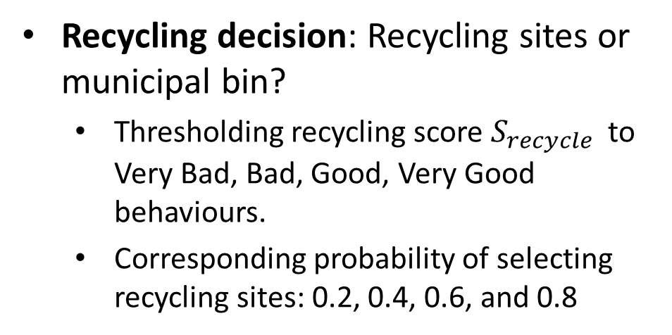
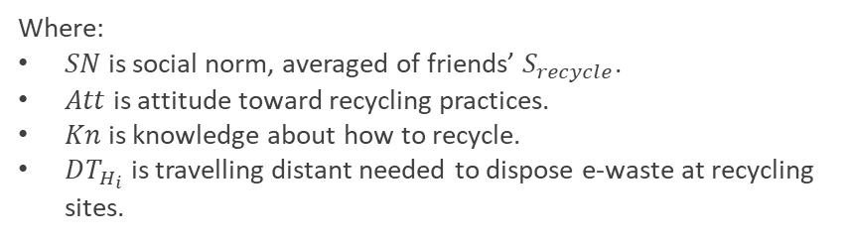
Resident (cont.)
Recycling decision: Recycling sites or municipal bin?
Thresholding recycling score $S_{recycle}$ to Very Bad, Bad, Good, Very Good behaviours.
Corresponding probability of selecting recycling sites: 0.2, 0.4, 0.6, and 0.8
Get new devices.
Make disposal decision.
Dispose e-waste?
No
New cycle
Yes
Make recycling decision.
$$S_{recycle}=β_{SN}⋅SN+β_{Att}⋅Att+β_{Kn}⋅Kn+β_{DT}⋅ DT_{H_{i}}$$
New cycle
New cycle
Where:
$SN$ is social norm, averaged of friends’ $S_{recycle}$.
$Att$ is attitude toward recycling practices.
$Kn$ is knowledge about how to recycle.
$DT_{H_{i}}$ is travelling distant needed to dispose e-waste at recycling sites.
Recycling sites
Disposing channel?
Municipal wastes bin
Transfer to recycling sites.
Transfer to municipal waste bin.
Activity diagram of resident at a cycle.

Slide 13
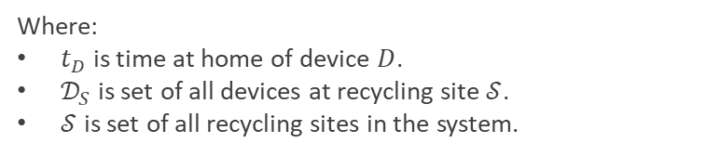
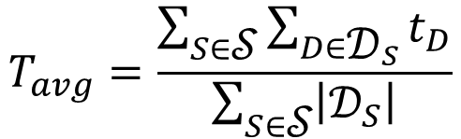
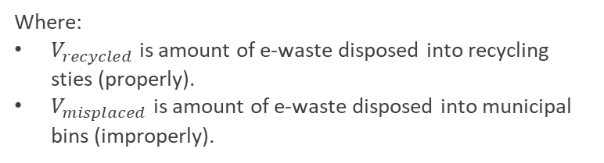
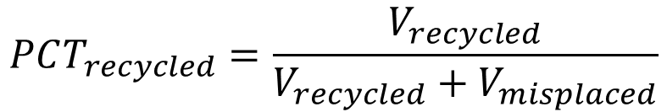
Recycling Indicators
Average retention time of e-waste:
$$T_{avg}=\frac{\sum_{S∈\text{𝒮}}{\sum_{D∈{\text{𝒟}}_{S}}{t_{D}}}}{\sum_{S∈\text{𝒮}}{\left|{\text{𝒟}}_{S}\right|}}$$
Where:
$t_{D}$ is time at home of device $D$.
${\text{𝒟}}_{S}$ is set of all devices at recycling site $\text{𝒮}$.
$\text{𝒮}$ is set of all recycling sites in the system.
Recycling rate:
$$PCT_{recycled}=\frac{V_{recycled}}{V_{recycled}+V_{misplaced}}$$
Where:
$V_{recycled}$ is amount of e-waste disposed into recycling sties (properly).
$V_{misplaced}$ is amount of e-waste disposed into municipal bins (improperly).

Slide 14


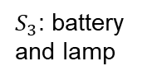
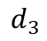
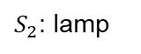
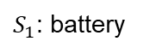
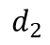
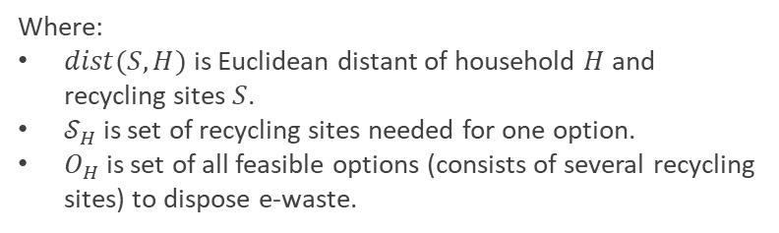
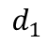
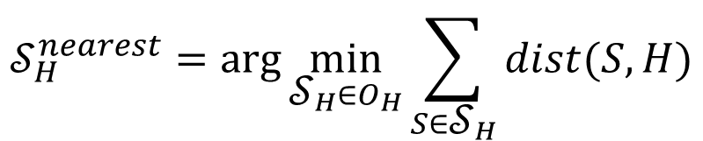
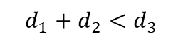
Nearest Recycling Sites Assignment Intervention
Promote e-waste recycling by increasing convenience associated with proximity.
Recycling sites with minimal travelling distance are assigned.
Assessed scenarios: Random Assignment and Nearest Recycling Sites Assignment.
$${\text{𝒮}}_{H}^{nearest}=\arg{\min_{{\text{𝒮}}_{H}∈O_{H}}{\sum_{S∈{\text{𝒮}}_{H}}{dist(S,H)}}}$$
$S_{3}$: battery and lamp
$$d_{3}$$
$$d_{1}$$
$S_{1}$: battery
Where:
$dist(S,H)$ is Euclidean distant of household $H$ and recycling sites $S$.
${\text{𝒮}}_{H}$ is set of recycling sites needed for one option.
$O_{H}$ is set of all feasible options (consists of several recycling sites) to dispose e-waste.
$$d_{2}$$
$$d_{1}+d_{2}<d_{3}$$
$S_{2}$: lamp
Illustration of Nearest Recycling Sites Assignment intervention. E-wastes at home: batteries and lamps. Assigned sites:${ \text{𝒮}}_{H}^{nearest}=\left(S_{1},S_{2}\right)$

Slide 15
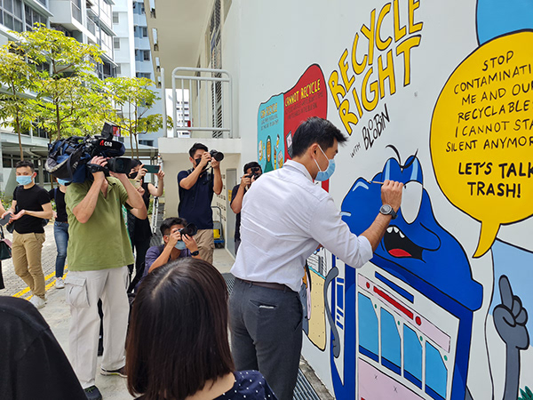
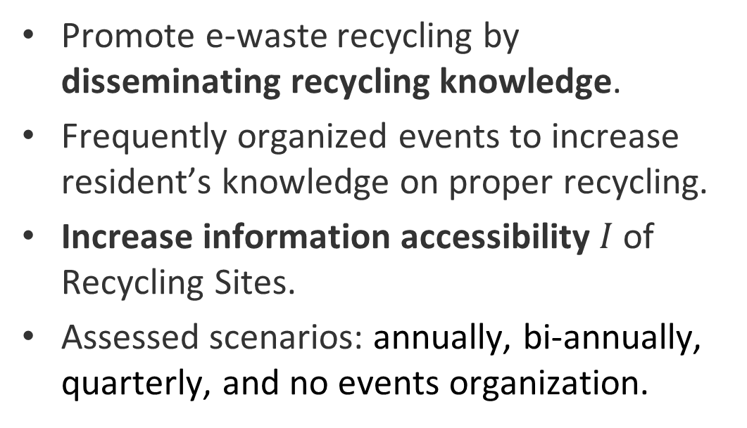
Recycling Information Campaign Intervention
Promote e-waste recycling by disseminating recycling knowledge.
Frequently organized events to increase resident’s knowledge on proper recycling.
Increase information accessibility $I$ of Recycling Sites.
Assessed scenarios: annually, bi-annually, quarterly, and no events organization.
Recycle Right campaign run by NEA in January 2022. Photos from Mural Lingo.
Do you remember that 60% of Singapore residents do not know or are unsure of how to recycle their electronic waste?

Slide 16
Experiment Scenarios
Baseline: random sites assignment and no recycling information campaign.
Nearest Recycling Sites Assignment.
Recycling Information Campaign: annually, bi-annually, quarterly events.
Enhanced Scenario: Nearest Recycling Sites Assignment and Recycling Information Campaign (bi-annual events).

Slide 17
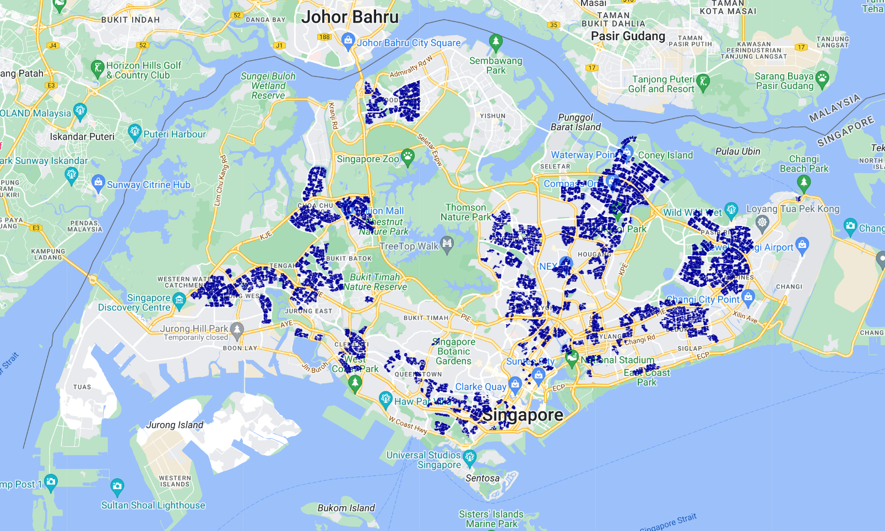
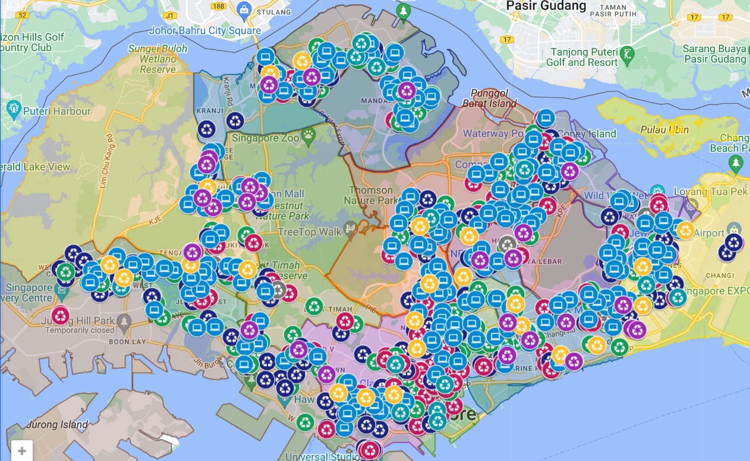
Implementation
GAMA Platform version 1.9.3.
Data:
NEA recycling sites.
Housing & Development Board (HDB) geometric data.
HDB property information.
More than 11,000 residents and 946 recycling sites.
Simulation: 2080 cycles = 20 years, repeated 4 times.
HDB geometric data.
NEA recycling sites.

Slide 18
Experiment results

Slide 19
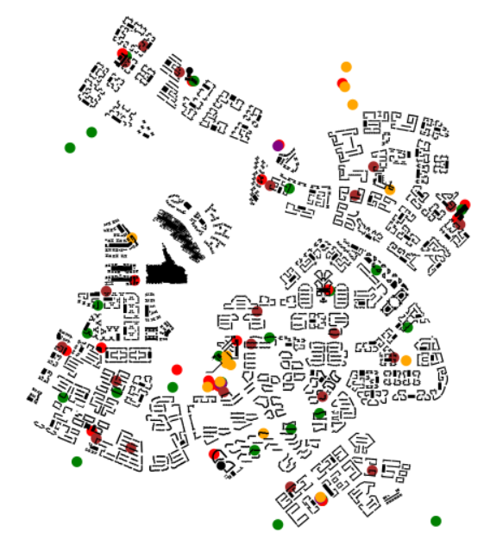
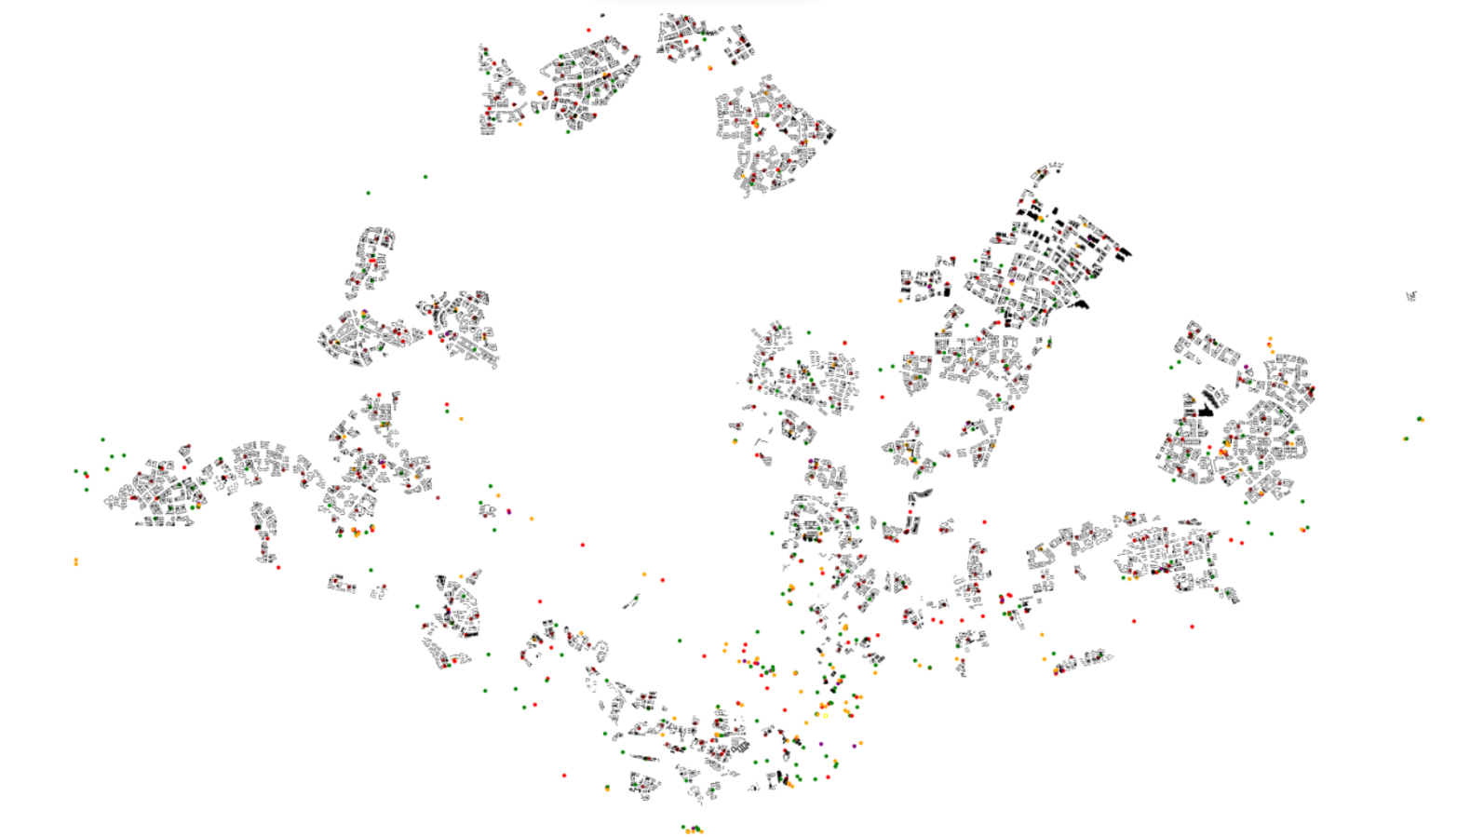
Simulation Visualization
Visualization of our simulation. Colored dots represent recycling sites. Blocks are HDB apartment buildings.
3-in-1 Bin
Battery-Only Bin
Battery & Bulb (BB) Bin
Manned In-Store Counter
E-waste Collection Drive
ALBA’s Depot Drop-off

Slide 20
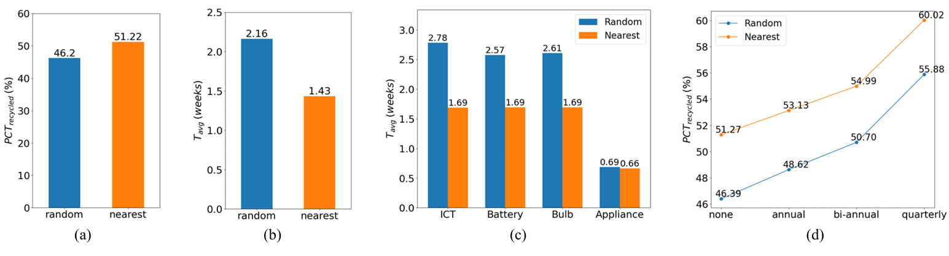
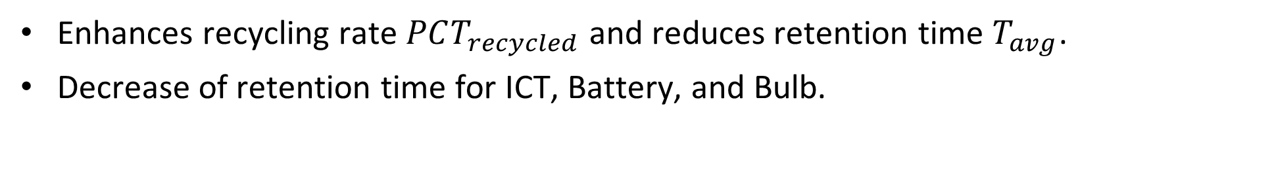
Nearest Recycling Sites Assignment
Enhances recycling rate $PCT_{recycled}$ and reduces retention time $T_{avg}$.
Decrease of retention time for ICT, Battery, and Bulb.
Results of Nearest Recycling Sites Assignment: (a) recycling rate $PCT_{recycled}$ (higher is better); (b) average retention time $T_{avg}$ (lower is better); (c) average retention time $T_{avg}$ by types of e-wastes (lower is better).

Slide 21
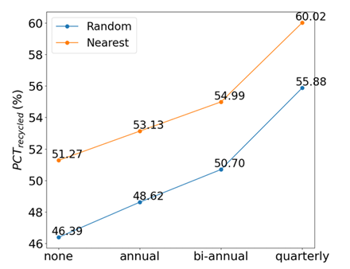
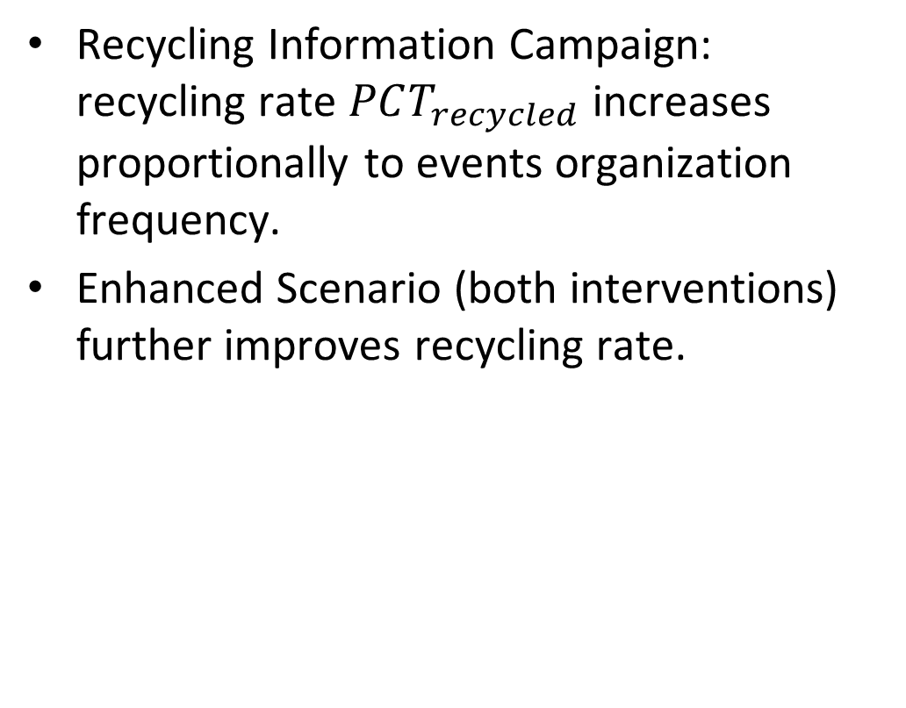

Recycling Information Campaign and Enhanced Scenario
Recycling Information Campaign: recycling rate $PCT_{recycled}$ increases proportionally to events organization frequency.
Enhanced Scenario (both interventions) further improves recycling rate.
Recycling Information Campaign result: recycling rate $PCT_{recycled}$ (higher is better) by campaign frequency.

Slide 22
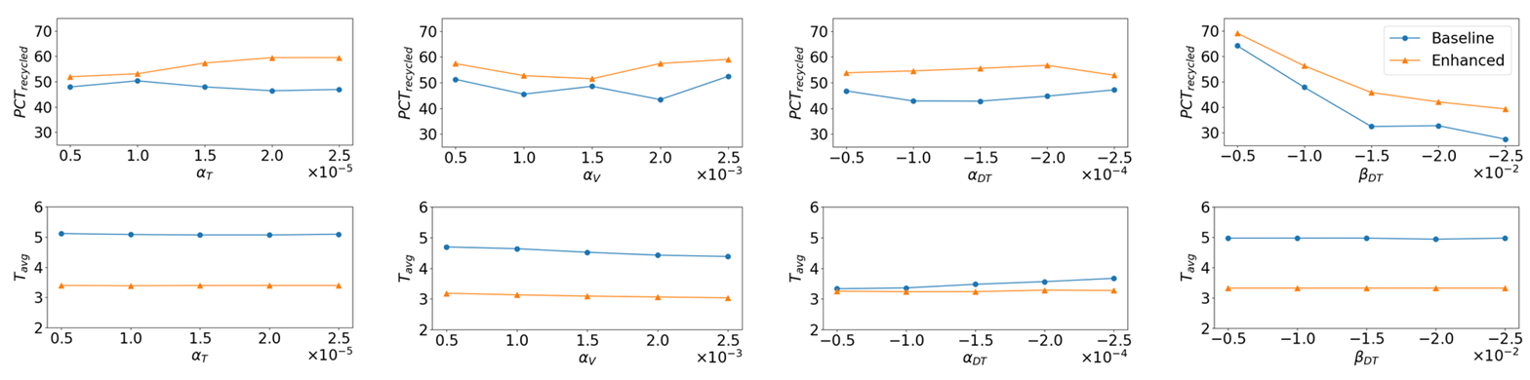
Sensitivity Analysis – Are the Results Trustworthy?
One-factor-at-a-time (OFAT) sensitivity analysis.
Scenarios: baseline (no intervention) and enhanced (both interventions).
Implementing interventions constantly improves recycling participation.
Results for sensitivity analysis on recycling rate $PCT_{recycled}$ (higher is better) and retention time $T_{avg}$ (lower is better). Baseline: no intervention is implemented. Enhanced: implementing both Nearest Recycling Sites Assignment and Recycling Information Campaign (bi-annual frequency).

Slide 23
Conclusion and Potential Developments

Slide 24
Conclusion
Agent-based model to simulate e-waste collection system and recycling behaviours in Singapore.
Provide policymakers with insight for interventions design.
Assessment of Interventions: Nearest Recycling Sites Assignment and Recycling Information Campaigns.
Visualization of our simulation. Colored dots represent recycling sites. Blocks are HDB apartment buildings.

Slide 25







Ideas for Potential Development
Exploration of other strategies: deposit refund schemes and incentive programs.
Collective Intelligence and Multi-Agent Reinforcement Learning to enhance recycling objectives by collaboration and competition of individuals.
Dynamic scheduling.
Same favorite vouchers.
Competition
Help with recycling?
Collaboration
Illustration of employing Collective Intelligence and Multi-Agent Reinforcement Learning to improve recycling objectives. Agents are self-interested with individual objectives. Residents may ask their friend to help recycling if they are busy, compete with others to gain favorite vouchers. Collecting trucks need collaboration for optimal dynamic routing.

Slide 26
Thank you!

